Slide 1
Certification Prep Course - Foundations of IBM Cloud V2
Exam C1000-083
Section 1 - IBM Cloud Overview
IBM Cloud
Hybrid, multi-cloud by design.
Designed for your data.
AI Ready.
Secure to the Core.

Slide 2
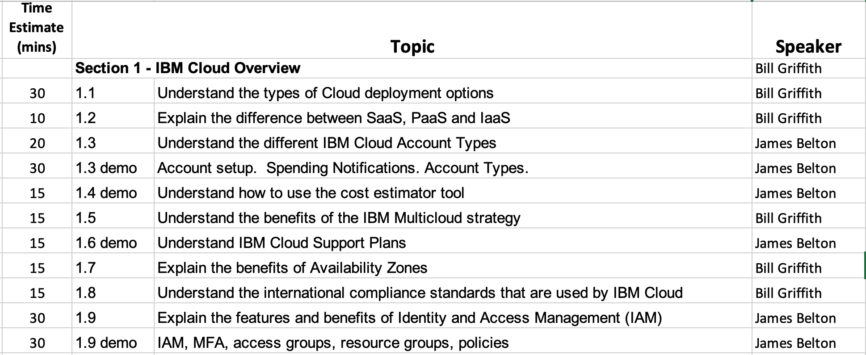
Agenda

Slide 3
Section 1.1 – Understand the types of Cloud deployment options
IBM Public Cloud - https://www.ibm.com/cloud/learn/public-cloud
A public cloud is a type of cloud computing in which a third-party service provider makes computing resources—which can include anything from ready-to-use software applications, to individual virtual machines (VMs), to complete enterprise-grade infrastructures and development platforms—available to users over the public Internet.
Public cloud architectures are multi-tenant environments—users share a pool of virtual resources that are automatically provisioned for and allocated to individual tenants through a self-service interface.
The public cloud provider owns and administers the data centers where customers’ workloads run.
IBM Private Cloud - https://www.ibm.com/cloud/learn/introduction-to-private-cloud
Private cloud (also known as an internal cloud or corporate cloud) is a cloud computing environment in which all hardware and software resources are dedicated exclusively to, and accessible only by, a single customer. Private cloud combines many of the benefits of cloud computing—including elasticity, scalability, and ease of service delivery—with the access control, security, and resource customization of on-premises infrastructure.
IBM Hybrid Cloud - https://www.ibm.com/cloud/learn/hybrid-cloud
Hybrid cloud is a computing environment that connects a company’s on-premises private cloud services and third-party public cloud into a single, flexible infrastructure for running the organization’s applications and workloads.

Slide 4





cloud is a set of capabilities not a place
Public
Hybrid
Private
Notes:
As you engage with different clients, it becomes clear that cloud journeys are moving at vastly different time scales, based on a company’s acumen, geography, and industry. For some, it’s a 5-year journey to the public cloud, for others it’s a 10-year, 20-year, or even longer journey. For most, especially large clients, it’s a hybrid journey and ultimately a quest for agility. I always tell people that ”Cloud is a capability not a place” because that more accurately describes what clients really want. After all, lots of enterprise data will solely be on premises because of data sovereignty laws, performance requirements, usage patterns (for example, to get data into the cloud it has to get loaded there), and performance (the number one reason to go to public clouds is anything but raw performance); and this has given rise to the private cloud.
So what do you do in the meantime? The biggest thing that I see happening in enterprises today, that ironically doesn’t get much media or analyst coverage, is the idea of private cloud. Private cloud is taking everything that we love about the public cloud – the economies, the agility, the flexibility, the composability of it – and bringing it to on-premises, behind the firewall. All the same ideas of virtualization, federation, queryable interfaces fronted with a REST API apply. This is happening right now, everywhere I go. Private cloud, for many organizations, is the logical step towards cloud. Personally, I think clients will end their journey where they hopefully started it – hybrid cloud (where some applications reside in public clouds and others in private clouds on premises).
The truth of the matter is that you can provision all the benefits of LinuxONE in a public or private cloud scenario ... so it’s good to help the client understand why public or private clouds for specific workloads and such (because that’s what a hybrid cloud is composed of). Putting aside regulatory compliance reasons (a major reason for many), let’s look at why you might choose to deploy certain workloads in the public cloud and why you might choose to deploy others in your private cloud.
First, public clouds are great for applications and workloads that have unpredictable or variable demands. For example, if a business launches a new online/mobile app (such as a new online shopping experience, a checking scanning app from a bank, and so on), the demand for the app or service is likely not initially well understood. In this case, public cloud allows businesses to ramp up resources for the app depending on demand. However, as the demand for the app becomes more stable/predictable, it may be more economical to deploy on premises.
Consider applications such as month-end payroll systems or online shopping portals that have highly variable/seasonal demands with peak demands that are several times the average. By not tying up idle infrastructure when not needed, businesses can save costs ... that screams for public cloud in many cases BUT for more predictable or stable workloads, which is well represented in many enterprise applications, public cloud services can be considerably more expensive than on-premises infrastructure.
At the end of the day, businesses truly want to balance owning and renting, choosing between private and public infrastructure depending on application workload characteristics. There are situations where it makes sense to rent, and others where owning is better economically. But clients want the same flexibility, scalability and agility that cloud provides regardless of the purchase/location model. No matter what that journey looks like; a brand new startup that isn’t interested in any on premises investments, a highly regulated bank that only wants on premises, or somewhere in between, IBM has a vast set of patterns, products, and experiences to support that journey. HOWEVER the piece to not lose sight of here is that across all operational aspects, agility is a key focus ... and agility benefits from higher level of compute no matter where it resides.
The take-away (or the new part for many) is that when people use the word “cloud” let’s ensure that it’s a style of computing as opposed to a location. All clients need cloud – be it public, private, or some combination thereof (hybrid). Private cloud is necessary for those who have data sensitivity needs either from internal policies, government regulations, or industry compliance requirements. While you will find these requirements across all industries, Government, Healthcare, and Financial (especially this group) compose the largest industry segments with these requirements.

Slide 5


Cloud Capabilities Desired
Self-service user experience, from anywhere
Pay as you go for what you use
Rapid access to resources – compute, storage, GPUs, network bandwidth
Deploy and scale apps rapidly – on demand
Simplified management and operations
Continuous software, infrastructure innovation
Thus Cloud is a capability and not a place
94% of organizations are using a mix of public and private clouds and are embracing a multicloud strategy
IDC Cloud Forecast 2018-2020
Notes:
This slide is just to punctuate what capabilities customers want and to emphasize that these capabilities are available with IBM’s public or private cloud options and if built on Red Hat Openshift, then you have consistency across premises locations.

Slide 6
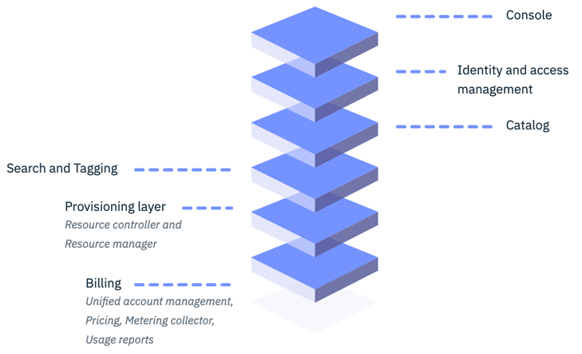
IBM Public Cloud Platform
The IBM cloud platform combines platform as a service (PaaS) with infrastructure as a service (IaaS) to provide an integrated experience.
IBM Cloud platform is composed of multiple layers:
A console that serves as the front end for creating, viewing, managing cloud resources
An identity and access management component that securely authenticates users for both platform services and controls access to resources consistently across IBM Cloud
A catalog that consists of hundreds of IBM Cloud offerings:
Compute:
Bare Metal Servers, Virtual Servers, Containers
Storage:
Block, File, Object
Network:
Gateways, Firewalls, Load balancers
The catalog supports command-line interfaces (CLIs) and a RESTful API .
A search and tagging mechanism for filtering and identifying your resources.
An account and billing management system that provides exact usage for pricing plans..
https://cloud.ibm.com/docs/overview?topic=overview-compare-infrastructure

Slide 7
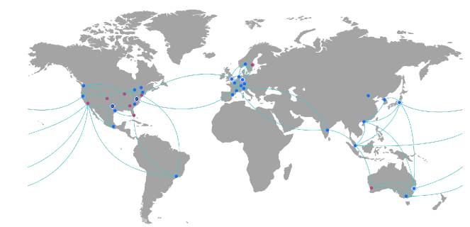
IBM Public Cloud The most open and secure cloud for business.
Enterprise-grade
Hyper-scale Cloud Provider with 60 global data centers in 18 countries connected over high speed (13Tbs) fiber (free egress).
HW choice (x86, Power, Z, GPU), OS choice (Linux, Windows, AIX, IBM i, BYOI), compute choice (VSI, Bare Metal, VMWare, Certified SAP, HPC, containers, Serverless) with 99.99% SLAs.
Flexible Exabyte (50% less disk) Object Storage tiering (50-75% cheaper) with Aspera high-speed transfer (100x faster).
Security Leadership
Highest level key protect tamper-proof hardware with zCrypto (KYOK with FIPS 140-2 Level 4 security protection).
Secure virtualization with Hytrust/Intel Txt or zLinux VSI including data sovereignty protection.
In-use data protection with Data Shield and z14 VSIs.
Open Innovation
IBM Cloud runs on Kubernetes with 19k+ clusters in production
Red Hat OpenShift fully managed on IBM Cloud.
Major contributor to cloud native open source work: Istio, Knative, Razee, Hyperledger, OpenWhisk, etc..
190+
Self-service Iaas/PaaS services
60+
IBM Cloud data centers across 18 countries & 5 continents
ONE Cloud Architecture
2500
Cloud –technology patents granted in 2019 to IBM
running Watson, Data, IBM Z, Power 9, Blockchain
2000+
VMWare clients
3000+
Managed SAP Instances
https://www.ibm.com/cloud
Notes:
Protect data at rest and in transit with IBM Hyper Protect services secured with IBM Z /Linux One HW. Firmware, and Secure Service Containers.

Slide 8

Businesses have turned to Hybrid, Multi-Cloud Architectures to reduce costs, innovate, and provide the customer experience of the future
$438B in 2020
18-20 CAGR 15%
$609B in 2020
18-20 CAGR 18%
<20%
Enterprise workloads have moved
Private
Clouds
Public Clouds
& SaaS
Dedicated
Clouds
Why?
Hybrid Cloud
81%
Security primary concern
82%
Multi-cloud integration concern
Traditional IT
$640B in 2020
18-20 CAGR -9%
77%
Lack of skills concern
Source: IBM MD&I; :McKinsey research
Notes:
Now we can talk about the latest technology to disrupt industries. This isn’t new: technologies have been disrupting since the beginning of time. Today it is Cloud; tomorrow it may be Quantum. The secret is to learn your client’s business and help them apply technology to their specific business processes.
Enterprises are moving to the Cloud in hopes of reducing costs to provide more value for their customer’s experience as well as a platform for rapid innovation to capture and retain customers. The challenge is no one cloud provides everything and thus 94% of Enterprises use multiple clouds – mixing public, private, dedicated, and countless SaaS applications together with rapid growth expected at least thru 2020.
This McKinsey study estimates more than $1 trillion cloud spend by 2020 across public and private cloud platforms.
To date, less than 20% of Enterprises have moved to the cloud despite the benefits that customers perceived will be achieved. The question becomes: why only 20%?
The key inhibitors to Enterprise Cloud adoption are (1) Security concerns; (2) Cloud Integration; and (3) Lack of skills.
Even for those looking to aggressively move to the cloud today, it will be a journey. Enterprises often have more than 1000 applications that are intertwined together and picking up one piece often requires other components to come along and the solution for one applications may not be the same “fit for purposes” solution for another application. The point is that each customer is on a unique cloud journey as there isn’t a “one-size-fits-all” solution.
Source: https://www.mckinsey.com/business-functions/digital-mckinsey/our-insights/cloud-adoption-to-accelerate-it-modernization
Source: Security 81% #1 concern; 77% lack of skills from 2018 RightScale survey: https://www.rightscale.com/lp/state-of-the-cloud

Slide 9
Cloud Native & Legacy apps will co-exist for the next 10+ years
You are here
Co-existence between legacy and cloud-native
Cloud Native
0
Time
Legacy
Target – Microservices architecture fully exposed to new and legacy applications
Coexistence will involve new and legacy applications working together
New features will be added to existing applications
Source: IBM
Notes:
Existing applications and new cloud native apps will continue to coexist for the next ten years as IT leaders incrementally modernize apps and workloads using containers and microservices, while connecting and adding value to existing investments in the data center.

Slide 10

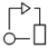


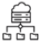



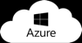


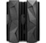
A Software Defined “Private Cloud” runs anywhere
Client Journey
Cloud
Strategy
Cloud
Migration
Cloud
Development
Cloud
Management
Cognitive Applications
IBM
Software
Red Hat
Software
Open Source
Software
3rd Party
Software
Infrastructure-independent common operating environment
OPEN | CONSISTENT | MULTI-CLOUD | PORTABLE | SCALABLE | INTEGRATED | SECURE | CERTIFIED & SUPPORTED
Red Hat
OpenShift
Red Hat Enterprise Linux
IBM Cloud
Edge
Private Cloud
Systems (x86, Power, Z)
Notes:
There are many challenges with moving to the cloud such as security, integration, skills, portability, vendor lock-in, multi-clouds, cloud premises, etc. Therefore, IBM acquired Red Hat as the Red Hat products, and especially Red Hat OpenShift, address a lot of these challenges already. And when you leverage the power of IBM’s products such as Watson, Blockchain, IBM Middleware, etc., you get a really powerful combination that enables customers to innovate quickly in a secure, trusted fashion while running anywhere without being locked into any specific vendor as Red Hat products are 100% Open Source. This significantly lowers our customer’s risks as they embark on the cloud journey. They can modernize on premise, safely behind their firewall, and be confident the same application will run on any Cloud provider when and if they choose to move the whole application to a public cloud or perhaps burst components of their application to a public cloud when demand increases. And since Red Hat OpenShift is the foundation for on-premise cloud, as well as any public cloud, the skills the DevOps team acquires will be preserved and transferrable, once again reducing the risk of migrating to the Cloud.
----------------------------
Enterprise Grade Infrastructure – Runs All Your Apps
Built from Open Source – No Technology Lock-in
Reliable, Extensible, Scalable – Grows with You
Multicloud enabled – Goes anywhere you need

Slide 11
Section 1.2 – Explain the difference between SaaS, PaaS, and IaaS.
Infrastructure as a Service (IaaS)
Infrastructure-as-a-Service (IaaS) is a cloud-computing offering in which a vendor provides users access to computing resources such as servers, storage and networking. Organizations use their own platforms and applications within a service provider’s infrastructure.
Instead of purchasing hardware outright, users pay for IaaS on demand.
Infrastructure is scalable depending on processing and storage needs.
Saves enterprises the costs of buying and maintaining their own hardware.
Platform as a Service (PaaS)
Platform as a service (PaaS) is a cloud computing offering that provides users with a cloud environment in which they can develop, manage and deliver applications. In addition to storage and other computing resources, users are able to use a suite of prebuilt tools to develop, customize and test their own applications.
Enables organizations to focus on development without having to worry about underlying infrastructure.
Providers manage security, operating systems, server software and backups.
Facilitates collaborative work even if teams work remotely.
Software as a Service (SaaS)
Software as a service (SaaS) is a cloud computing offering that provides users with access to a vendor’s cloud-based software. Users do not install applications on their local devices. Instead, the applications reside on a remote cloud network accessed through the web or an API.
SaaS vendors provide users with software and applications via a subscription model.
Users do not have to manage, install or upgrade software; SaaS providers manage this.
Applications are accessible from almost any internet-connected device, from virtually anywhere in the world.
https://www.ibm.com/cloud/learn/iaas-paas-saas

Slide 12
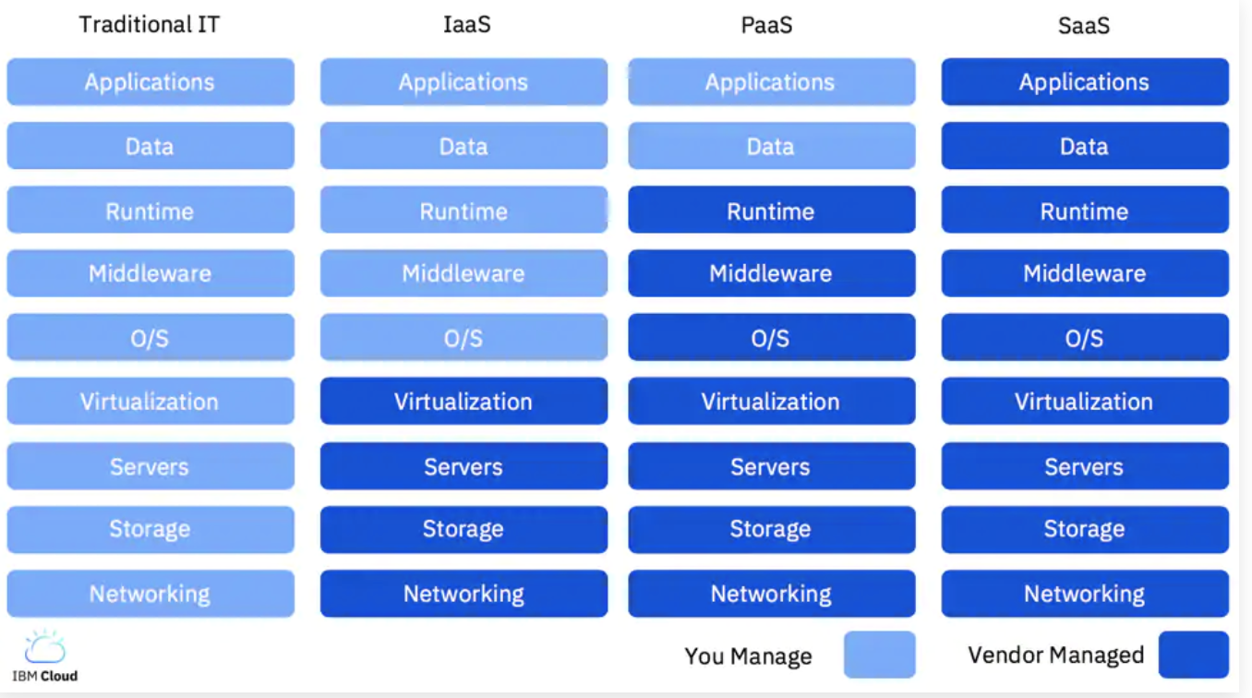
Cloud Provider Responsibility
https://www.ibm.com/cloud/learn/iaas

Slide 13
Section 1.3 – Understand the different IBM Cloud Account Types
Lite
Your Lite account doesn't expire and your credit card isn't required.
Pay-as-You-Go (PAYGO)
With a Pay-As-You-Go account, you can access the full IBM Cloud catalog, including all free plans.
You pay only for billable services that you use, with no long-term contracts or commitments.
Subscription
When you purchase a subscription, you commit to a minimum spending amount for a certain period of time and receive a discount on the overall cost.
Subscription accounts provide discounts for platform services and support and more consistent billing through subscriptions.
Account Billing
IBM Cloud™ charges vary depending on the resources that are used by a particular service, runtime, container, or support option. The resources can be the number of API calls, the number of instances, memory, or storage.
Apply promotion codes
Promotions are limited-time credits toward your IBM Cloud™ account and services that you can get by applying promo codes.
https://cloud.ibm.com/docs/billing-usage?topic=billing-usage-applying-promo-codes
Spending Notifications
If you have an IBM Cloud™ Pay-As-You-Go or Subscription account, you can set up email spending notifications. You can enable spending notifications for total account, runtime, container, and service spending, or add spending for individual services, including third-party services.
https://cloud.ibm.com/docs/account?topic=account-accounts

Slide 14
The Different Types of IBM Cloud Account

Slide 15
IBM Cloud Accounts what are the different account types?
Lite
Pay as you Go (PAYGO)
Subscription

Slide 16
IBM Cloud Accounts lite account
Completely Free of Charge
Designed for proof of concept / light development work
Can only use Lite services
Can only create Cloud Foundry managed services in one region
Great for starting out
Account can be upgraded at any time

Slide 17
IBM Cloud Accounts lite account
The account is free - no credit card required.
The account never expires.
You can use one org in one IBM Cloud region.
Basic IBM Cloud support for free. Basic support is provided for non-production environments or workloads where traditional severities are not used and specific response times are not stipulated.
You receive email notifications about your account status and quota limits.
Your Cloud Foundry apps can access up to 256 MB of free, instantaneous runtime memory.
You can provision one instance of any service in the IBM Cloud catalog that has a Lite plan.
After 10 days of no development activity, your apps go to sleep. You can start working on new apps without having to worry about hitting memory quota limits.
After 30 days of no development activity, your service instances with Lite plans are deleted. This way, you don't have to manage deleting inactive instances before you create new ones.

Slide 18
IBM Cloud Accounts PAYGO account
Account becomes PAYGO when you supply credit card details
Access to all services, all plans, all regions
Charges based on use of services
Access to Lite (free of charge) services
Eligible for free tier allowances on runtimes and services
Billed monthly
Promotional credit of $200 (USD) when you upgrade (see T&C’s)

Slide 19
IBM Cloud Accounts subscription account
Designed for organisations with larger monthly spends (over $1K per month)
Upgrade by contacting IBM Cloud sales
Commitment to a combined minimum spending amount per month
Subscription discount is applied to that amount
Spending over the subscription amount is then charged at the non-discounted rate
Full access to all services in all regions

Slide 20
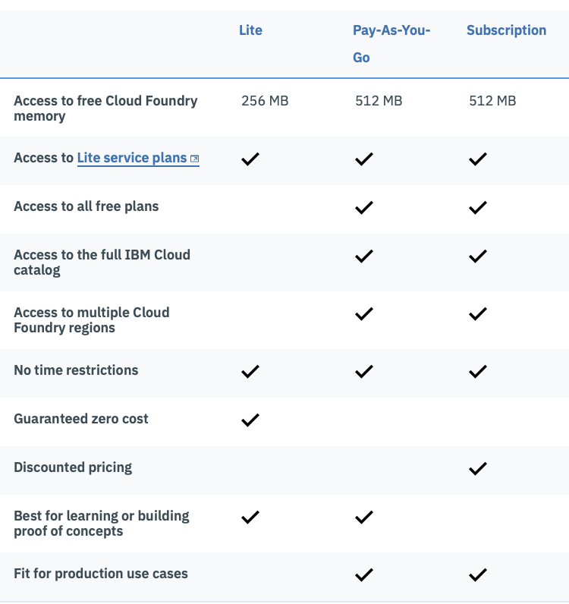
IBM Cloud Accounts comparison
Table source:
https://console.bluemix.net/docs/account/index.html#accounts

Slide 21
IBM Cloud Accounts one more thing……
You can invite other people to work in your account
You can be invited to work in other people’s accounts

Slide 22
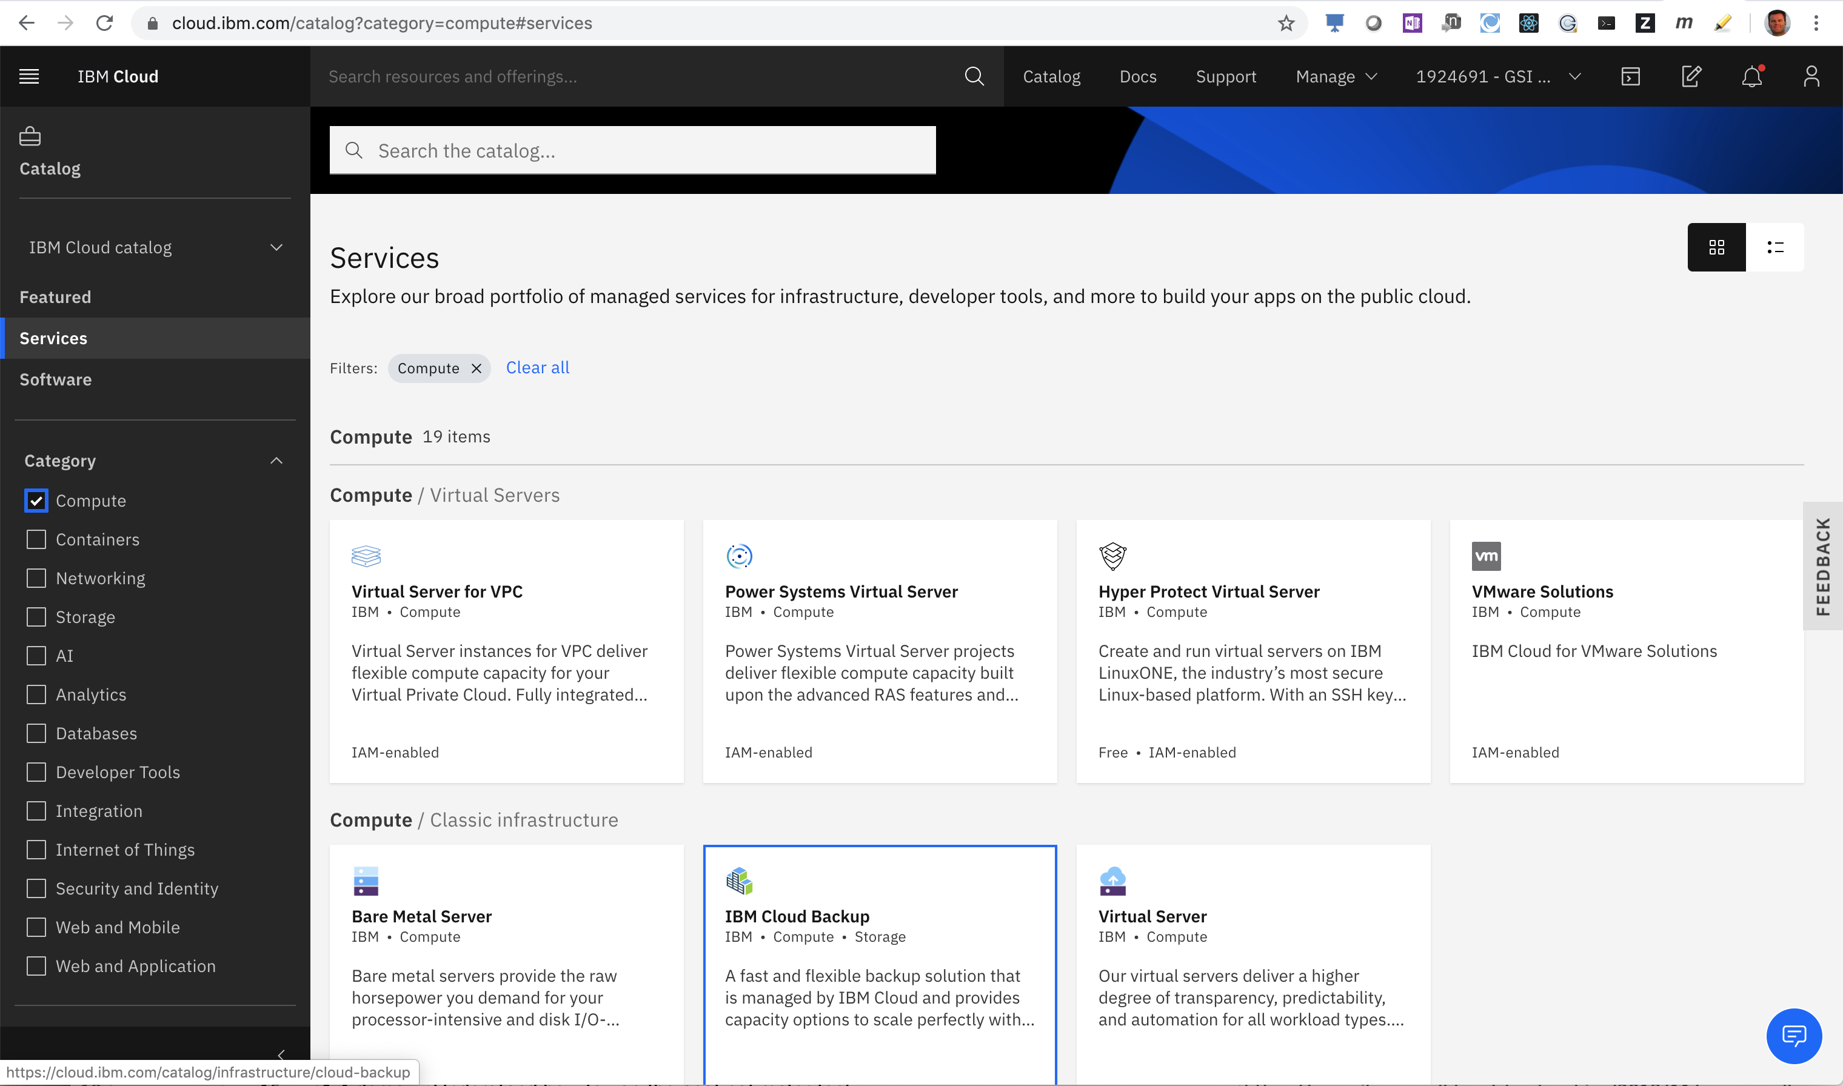
Section 1.3 – IBM Cloud Onboarding Demo
https://www.youtube.com/watch?v=rSjuK78AuR0

Slide 23
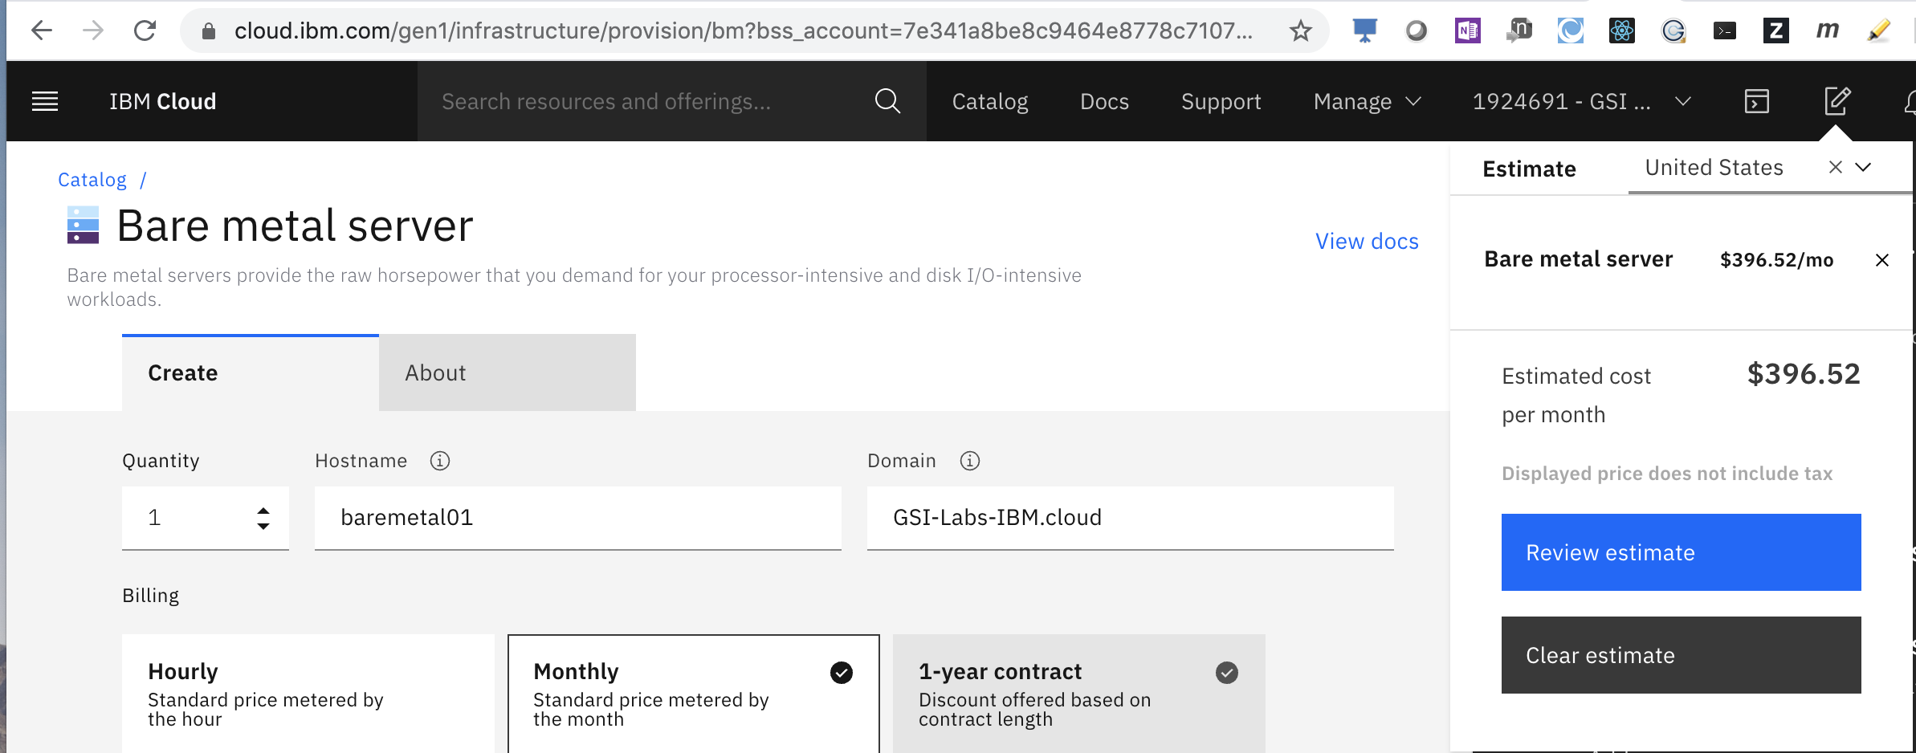
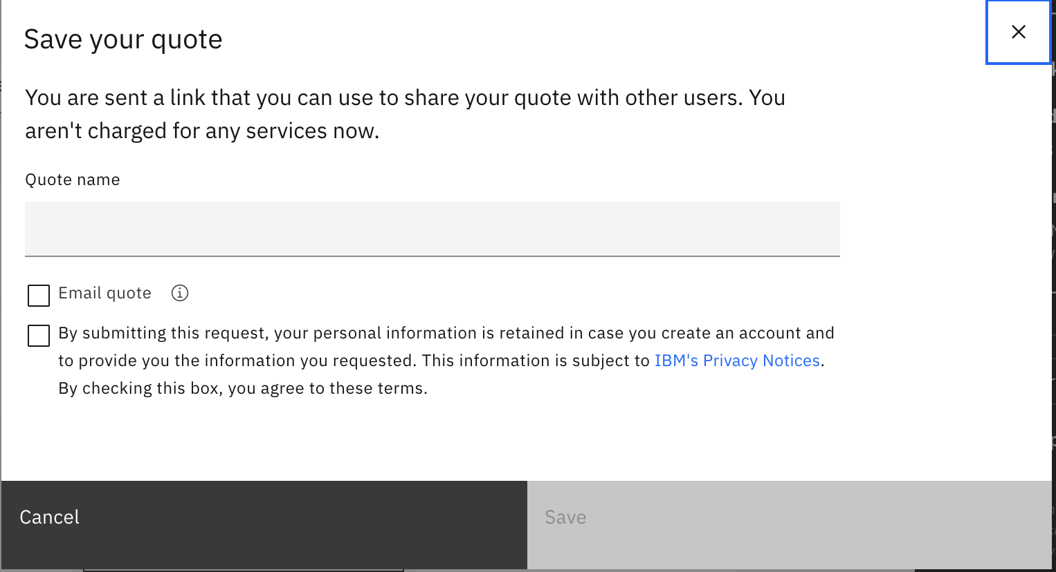
Section 1.4 – Understand how to use the cost estimator tool - Demo
Estimator Tool
Quotes
https://cloud.ibm.com/estimator/review

Slide 24
Section 1.5 – Understand the benefits of the IBM Multicloud strategy
Single Cloud Environment – A single cloud provider.
Multi-Cloud Environment – Multiple cloud providers.
Hybrid Mono-Cloud: Hybrid monocloud is hybrid cloud with one cloud provider—essentially an extension of a single public cloud provider’s software and hardware stack to the customer’s on-premises environment so that the exact same stack runs in both locations. The two environments are tethered together to form a single hybrid environment, managed from the public cloud with the same tools used to manage the public cloud provider’s infrastructure.
Hybrid Multi-Cloud: Hybrid multicloud is an open standards-based stack that can be deployed on any public cloud infrastructure. That means across multiple providers as well as on premises. As with hybrid monocloud, the environments are tethered together to form a single hybrid environment, but management can be done on- or off-premises and across multiple providers, using a common set of management tools chosen by the customer.
Considerations
Vendor Lock-in – open source/open standards based reduces vendor lock-in
Flexibility – hybrid multi-cloud provides more choice and flexibility
Privacy and Security – hybrid multi-cloud allows you to choose the best deployment option for your privacy/security concerns
Complexity and sprawl – hybrid multi-cloud reduces complexity by providing a consistent “software defined cloud” platform
https://www.stratoscale.com/blog/it-leadership/cloud-clouds-choose-single-multi-cloud-approach/

Slide 25









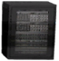
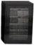












Enterprises have a Hybrid Multicloud Landscape
IBM Cloud
Public Clouds
Private Clouds
DMZ
Enterprise
DMZ
Social & Internet Data sources
Mobile, PoS, ATMs
APP
Service
APP
APP
DB
Service
APP
DB
APP
DB
Internet
Internet
API
API
Internet of Things
Sensors
Developer & Customer communities
Trading partner communities
Master Data Management
Big Data
Notes:
25
define APIs that you want to expose outside
add mobile access to your env. i.e. create mobile apps that access your enterprise and provide service.
add bigdata, analytics and take advantage of social media. Also IOT
trading partner communities and customer communities to gain access to your enterprise function through APIs. Think bestbuy api and Google map api

Slide 26


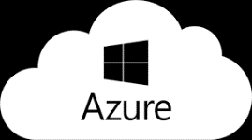
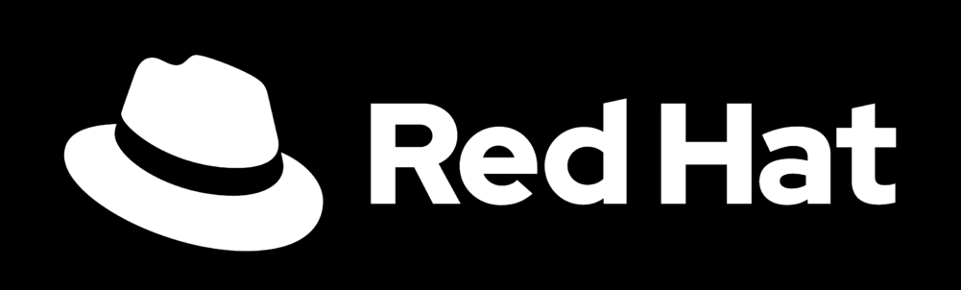
Two approaches to addressing hybrid cloud…
Hybrid Monocloud
Hybrid monocloud is hybrid cloud with one cloud provider—essentially an extension of a single public cloud provider’s software and hardware stack to the customer’s on-premises environment so that the exact same stack runs in both locations.
Hybrid Multicloud
Hybrid monocloud is an open standards-based stack that can be deployed on any public cloud infrastructure. That means across multiple providers as well as on premises.
Like for like
Same software
Same hardware
Single-vendor portability
Single-vendor management
Consistent stack across clouds
Choice of cloud vendors
Open standards-based
Multi-vendor portability
Multicloud management
“81% of public cloud users are using 2+ cloud providers.” – Gartner survey.
Notes:
Gartner defines two types of hybrid cloud: hybrid monocloud and hybrid multicloud. These types are loosely defined as follows, but the specific implementation can vary depending
on the provider.
Hybrid monocloud is a like-for-like model in which a cloud provider offers the same consistent, proprietary software and hardware stack running on premises as what’s available on its public cloud. The two environments are tethered to each other to form a hybrid environment, which is typically managed from the public cloud using public cloud management capabilities. In essence, the hybrid model is an extension of the public cloud to on premises.
If you have a cloud strategy that embraces infrastructure, platform, and SaaS from a single vendor, there are real advantages to a hybrid monocloud approach. You have a single vendor to procure, bill and support with a consistent approach to develop, integrate, deploy, secure and manage applications and data, enabling greater efficiencies across your staff and potentially greater economies of scale overall.
Hybrid multicloud is an open standards-based software stack, typically based on Kubernetes, that can be deployed across virtually any public cloud infrastructure and on premises. These two environments are tethered to form a hybrid environment, so management can be done on premises or off premises, but also across multiple cloud providers using the same management tools. A hybrid multicloud environment is, therefore, agnostic to the cloud provider and infrastructure.
If you have multiple cloud providers today, then a hybrid multicloud approach offers distinct advantages. You can address more use cases while mitigating the risks
associated with a single vendor approach, such as vendor lock in or a single point of failure. Like hybrid monocloud environments, you can develop, integrate, deploy, secure and manage consistently. However, this method extends across all your cloud vendors, granting you access to new cloud technologies and data from more sources. Plus, you have the ability to move workloads between clouds and vendors as needed to optimize for performance, costs, security or compliance needs.
Hybrid multicloud is an open standards-based software stack,
typically based on Kubernetes, that can be deployed across
virtually any public cloud infrastructure and on premises. These
two environments are tethered to form a hybrid environment,
so management can be done on premises or off premises,
but also across multiple cloud providers using the same
management tools. A hybrid multicloud environment is,
therefore, agnostic to the cloud provider and infrastructure.
If you have multiple cloud providers today, then a hybrid
multicloud approach offers distinct advantages. You
can address more use cases while mitigating the risks
associated with a single vendor approach, such as vendor
lock in or a single point of failure. Like hybrid monocloud
environments, you can develop, integrate, deploy, secure
and manage consistently. However, this method extends
across all your cloud vendors, granting you access to new
cloud technologies and data from more sources. Plus, you
have the ability to move workloads between clouds and
vendors as needed to optimize for performance, costs,
security or compliance needs.

Slide 27




Foundation – Hybrid Multicloud
Modernize once,
Avoid recoding expense
Innovate anywhere
with anyone’s technology
Move freely,
optimize for cost savings
Foundation
Common Services | RHEL | RH OpenShift | Multi-cluster Management
Infrastructure
IBM Public Cloud
AWS
Azure
Google
Edge
Private
Systems
OpenShift Kubernetes platform for portability
Choice of more cloud vendors and infrastructure
Deployable as untethered private cloud, on premises
Support for multiple open standards across hybrid
Virtualization to bridge legacy to the cloud
Common services for consistency and compliance
27
Notes:
Here we summarize the value proposition of the underlying platform:
Investment protection by modernizing one time
Leverage innovation from where-ever it arises
Move the compute and data to where it provides the most value
Manage, Govern, and Maintain visibility across your full enterprise landscape

Slide 28
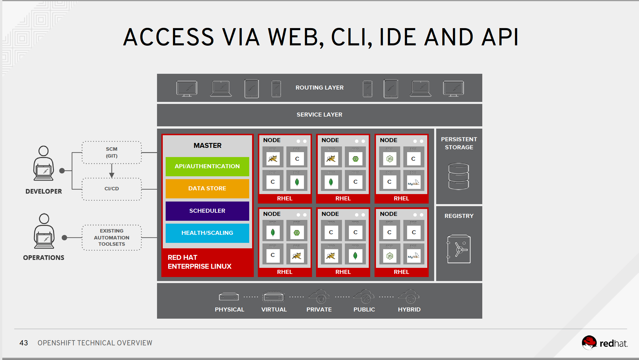

Slide 29
A next generation platform for a multicloud world
OFFERINGS
GSI Services to Accelerate Cloud Adoption
ACCELERATORS
GSI SERVICES &
OFFERINGS
Services Offerings & Practices
Solutions
Reference Architectures
Migration & Transformation Tools
CERTIFIED PRODUCT OFFERINGS & CLOUD SERVICES
CERTIFIED
PRODUCTS &
CLOUD SERVICES
OFFERINGS
(IBM Cloud Paks)
CLOUD
NATIVE
DEVELOPMENT
IBM Cloud Pak for Applications
TRADITIONAL
MIDDLEWARE AND DATA
IBM Middleware & Data Software as Containers
INTEGRATION
IBM Cloud Pak for Integration
BUSINESS
AUTOMATION
IBM Cloud Pak for Automation
DATA & AI
IBM Cloud Pak for Data
(incl. Watson)
SECURITY & MANAGEMENT
IBM Cloud Pak for Management
Best Practices, Methods & Reference Architectures
IBM Cloud Garages & Red Hat Innovation Labs
Infrastructure-independent common operating environment
CORE PLATFORM
OFFERINGS
OPEN | CONSISTENT | MULTI-CLOUD | PORTABLE | SCALABLE | INTEGRATED | SECURE | CERTIFIED & SUPPORTED
COMMON SERVICES
MULTI CLUSTER MANAGEMENT
OPENSHIFT
CONSISTENT
RUNTIMES & MANAGEMENT
ANSIBLE TOWER & INSIGHTS
Ecosystem,
Certification & Support
RHEL, OPENSTACK, RHV, VMware
SATELLITE & CLOUDFORMS
INFRASTRUCTURE
OFFERINGS
Power, z, Storage
IBM Cloud Bare metal & IaaS
Other cloud providers
Partners
Private Cloud
Infrastructure
IBM Public Cloud
Infrastructure
Other Public Cloud
Infrastructure
TRADITIONAL
29
Notes:
To unpack this architecture a bit more and declare this as the new SOA, the new Enterprise Architecture for the Cloud Era. This architecture provides a holistic enterprise architecture across vendors, across hardware, across workloads – in a portable, scalable, open standards based fashion that future proofs the investments you make today.
The components and services that ride on this architecture will continue to expand with the likes of Quantum computing, Edge computing, 5G, IOT devices, Robotics, Blockchain, Wearables, Augmented Reality, etc. but this architecture will support the speed and agility you will need for the next decade at least.

Slide 30





Red Hat OpenShift Provides an Open Software Defined Cloud Platform Allows consistency and portability without vendor lock-in across the hybrid multiple cloud reality
IBM + Red Hat
AWS
Microsoft
Google
Public Cloud
IBM Public Cloud OpenShift optimized
AWS
OpenShift
Azure
OpenShift
Google
Cloud
OpenShift
↻
Limited
feature
support
Limited
feature
support
Extensive
multicloud
governance / mgmt.
Private Cloud
IBM Private Cloud OpenShift optimized
AWS Outposts
Azure Stack
Google Anthos
Limited
connectivity in storage/data movement
Connectivity to Microsoft products
Limited
connectivity
Traditional on-premises
Traditional workloads
30
Notes:
The reality is that no one vendor has cornered the “innovation market”. IBM has great innovation, but so does Google and Microsoft and others. As an end-customer, you want to leverage the best feature/capability to serve your clients and thus you will need to get that technology from different providers and companies realize that 1 provider to rule-them-all is a risky proposition for the decades the application is likely to run.
Question: But how do you cherry-pick the key features of innovation that you need to drive that next customer experience in a way that you can manage it with the other components of your solution?
Answer: For this, you need an abstraction layer that pulls together the multiple components across providers and allows portability across premises and across vendors.
Question: But then how do you prevent being ”locked-in” to this abstraction layer?
Answer: You base the architecture on Open Source! By building on Open-Source, you can run across providers or download the code and manage things yourself and and forgo licenses costs! Of course, nothing is free and you are unlikely to build and manage your own Open Source products for cheaper than Red Hat can, BUT you have that choice – no proprietary code that your business depends on and your hands are tied.
Thus IBM with Red Hat is delivering the first complete open hybrid (vertically hybrid and horizontally hybrid) cloud platform that lets you develop, run and manage apps and workloads in a consistent way, across all your clouds - on and off premises. Modernize once, Innovate anywhere and freely move across clouds.
The foundation for our approach is an open infrastructure independent common operating environment to securely develop and manage applications, workloads and data across any cloud environments and vendor. Because its based on Red Hat’s open container and Kubernetes technology, RH OpenShift, you gain portability, choice and access to any cloud infrastructure (x86, Power, Z), on or off prem all with a consistent set of common services (access and identity, monitoring, etc), and full visibility across all your clouds and clusters.

Slide 31


IBM Cloud Strategy Brings Hybrid Multi-Cloud to Enterprise
IBM Cloud Strategy delivers faster time to value, lowers development and operational costs
Write Once – Deploy Anywhere – Operate Everywhere
Containerized Microservices
Containerized Microservices
Distributed
On-Premise
Public
IBM
Cloud Paks
Edge
APPs
AI
APPs
IBM
Cloud Paks
IBM
Cloud
Paks
Client
LOB Apps
LOB
APPs
NEW
APPs
AI
APPs
Data
APPs
LOB
APPs
NEW
APPs
AI
APPs
Data
APPs
Client
LOB Apps
IBM Cloud Services
Watson
Security
Weather
IBM
MW
IBM
MW
Database
RHEL
OpenShift
zOS, AIX, IBM i
OpenShift
OpenShift
zOS, AIX, IBM i
OpenShift
IBM Edge Cloud
x86, POWER, Storage
IBM On Premise Cloud
x86, POWER, Z, Storage
IBM Public Cloud
x86, POWER, Z, Storage
IBM Cloud Pak for Multicloud Management
Single dashboard to manage all of your clusters: Public, Private and Distributed
…etc.
31
Notes:
Overall IBMs Cloud strategy is to enable our clients to deploy on whatever cloud or systems architecture is optimal for the business need. In the second phase of cloud, the requirements of the workload are going to drive a more hybrid multi-cloud deployment to enterprise-class systems. Our strategy is focused on containers, Kubernetes and RedHat OpenShift plus IBM Cloud Paks in particular as the way to enable this reality. Allowing clients to leverage Power, Z and IBM Storage platforms that bring better performance and enterprise class capabilities with RedHat enterprise linux and OpenShift.
----------------------------
Enterprise Grade Infrastructure – Runs All Your Apps
Built from Open Source – No Technology Lock-in
Reliable, Extensible, Scalable – Grows with You
Multicloud enabled – Goes anywhere you need

Slide 32
Section 1.6 – Understand IBM Cloud Support Plans
Support Tickets
If you experience problems with IBM Cloud™, you have several options to get help with determining the cause of the problem and finding a solution. If you're logged in, you can go directly to the Support center to review your product topics and featured FAQs, open or manage a support case, or search community content.
IBM Cloud Support Plans
You can choose a Basic, Advanced, or Premium support plan to customize your IBM Cloud™ support experience for your business needs. The level of support that you select determines the severity that you can assign to support cases and your level of access to the tools available in the Support Center.
Community Support
All IBM Cloud customers are provided with free technical support through the community and blogs. Go to Asking a question for more information.
https://cloud.ibm.com/docs/get-support?topic=get-support-support-plans

Slide 33
Section 1.7 – Explain the benefits of Availability Zones
IBM Cloud Region
A region is a geographically and physically separate group of one or more availability zones with independent electrical and network infrastructures isolated from other regions. Regions are designed to remove shared single points of failure with other regions and guarantee low inter-zone latency within the region.
IBM Availability Zones (AZ)
An availability zone is a logically and physically isolated location within an IBM Cloud region with independent power, cooling, and network infrastructures. It is isolated from other zones to strengthen fault tolerance by avoiding single points of failure between zones while also guaranteeing high bandwidth and low inter-zone latency within a region.
Single Zone Regions (SZR)
A region with less than three availability zones. This provides data residency, but less cross-data-center availability protection.
Multizone Regions (MZR)
An MZR is comprised of 3 or more zones that are independent from each other to ensure that single failure events affect only a single zone. MZRs provide low latency (< 2 milliseconds latency) and high bandwidth (> 1000 Gbps) connectivity across zones. Any GA service in an MZR will be available in all MZRs within 90 days.
The advantage of an MZR is that it provides consistent cloud services across different zones, better resiliency, availability, higher interconnect speed between data centers for your resources. These features can be critical to your applications. Deploying the application in an MZR rather than a SZR can increase the availability from 99.9% to 99.99% when deployed over 3 zones.
https://www.ibm.com/cloud/blog/what-services-can-you-expect-in-ibm-cloud-availability-zones

Slide 34
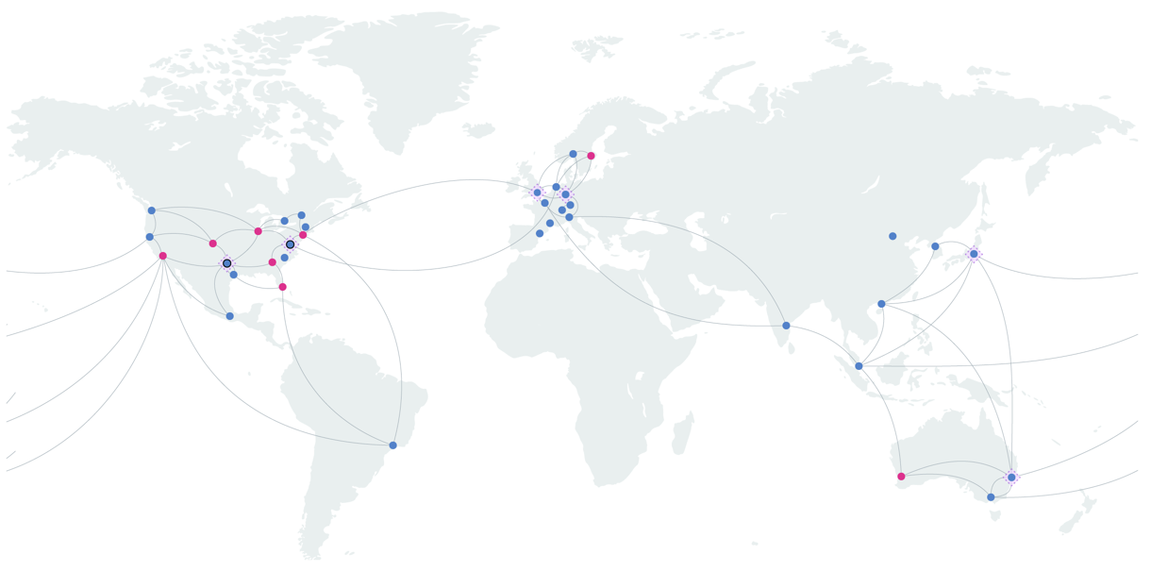
IBM Cloud Data Centers
IBM Location Code | Location Type
Amsterdam 1 | DC
Amsterdam 2 | PoP
Amsterdam 3 | DC
Atlanta 1 | PoP
Chennai 1 | SZR
Chicago 1 | PoP
Dallas 10 | MZR (AZ1)
Dallas 12 | MZR (AZ2)
Dallas 13 | DC(AZ3)
Dallas 3 | PoP
Dallas 4 | PoP
Dallas 5 | DC
Dallas 6 | DC
Dallas 7 | DC
Dallas 9 | DC
Denver 1 | PoP
Frankfurt 1 | PoP
Frankfurt 2 | MZR (AZ1)
Frankfurt 3 | PoP
Frankfurt 4 | MZR (AZ2)
Frankfurt 5 | MZR (AZ3)
Hong Kong 1 | PoP
Hong Kong 2 | DC
Hong Kong 3 | PoP
Houston 2 | DC
London 1 | PoP
London 2 | DC
London 3 | PoP
London 4 | MZR (AZ1)
London 5 | MZR (AZ2)
London 6 | MZR (AZ3)
Los Angeles 1 | PoP
Melbourne 2 | PoP
Mexico 1 | DC
Miami 1 | PoP
Milan 1 | DC
Milan 2 | PoP
Montreal 1 | DC
Montreal 2 | PoP
IBM Location Code | Location Type
New York City 2 | PoP
New York City 3 | PoP
Osaka 1 | PoP
Oslo 1 | PoP
Oslo 2 | DC
Paris 1 | DC
Paris 2 | PoP
Perth 1 | PoP
San Jose 2 | PoP
San Jose 3 | DC
San Jose 4 | DC
Sao Paulo 1 | DC
Sao Paulo 2 | PoP
Seattle 1 | DC
Seattle 2 | PoP
Seoul 1 | SZR
Seoul 2 | PoP
Singapore 1 | DC
Singapore 2 | PoP
Stockholm 1 | PoP
Sydney 1 | MZR (AZ1)
Sydney 2 | PoP
Sydney 3 | PoP
Sydney 4 | MZR (AZ2)
Sydney 5 | MZR (AZ3)
Tokyo 1 | PoP
Tokyo 2 | MZR (AZ1)
Tokyo 3 | PoP
Tokyo 4 | MZR (AZ2)
Tokyo 5 | MZR (AZ3)
Toronto 1 | DC
Toronto 2 | PoP
Washington DC 2 | PoP
Washington DC 4 | MZR (AZ1)
Washington DC 5 | PoP
Washington DC 6 | MZR (AZ2)
Washington DC 7 | MZR (AZ3)
IBM Cloud federal data centers - Cloud infrastructure built to government specs
Built to meet FedRAMP and FISMA privacy and security standards.
Connected to each other through an independent, high-speed private network.
Ashburn, Virginia.
Dallas, Texas.
https://cloud.ibm.com/docs/overview?topic=overview-locations&locale=en

Slide 35
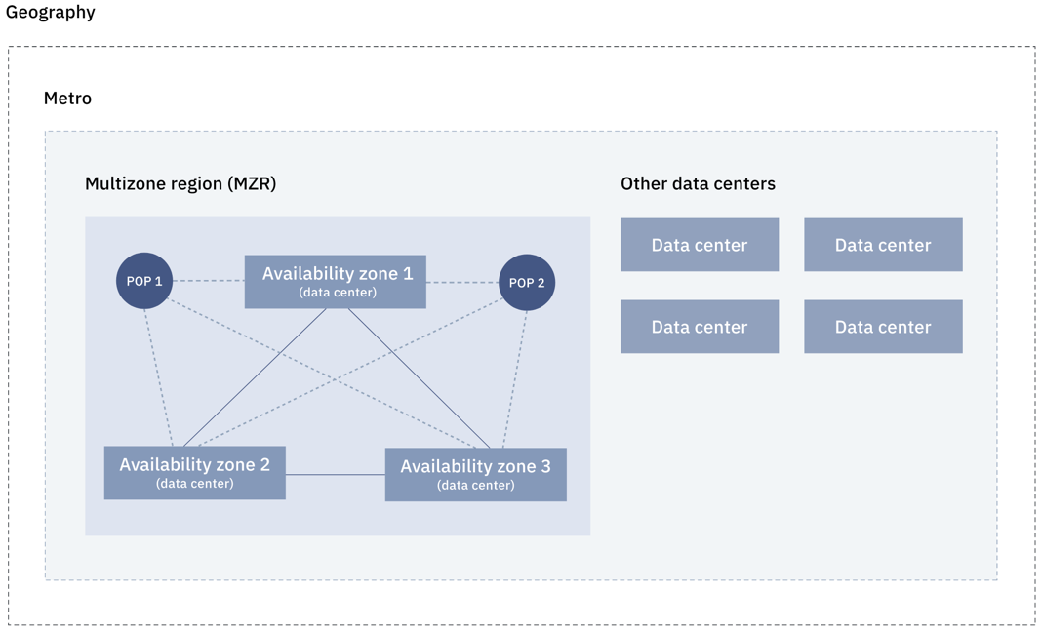
Multi-Zone Regions
Multi-Zone Region (MZR) - is comprised of 3 or more zones that are independent from each other to ensure that single failure events affect only a single zone.
MZRs provide low latency (< 2 milliseconds latency) and high bandwidth (> 1000 Gbps) connectivity across zones.
us-south: dal10, dal12, dal13
us-east: wdc04, wdc06, wdc07
eu-gb: lon04, lon05, lon06
eu-de: fra02, fra04, fra05
jp-tok: tok02, tok04, tok05
au-syd: syd01, syd04, syd05
Single-Zone Regions (SZR) - Single zone.
Seoul
Chennai
3
6
6
3
3
https://cloud.ibm.com/docs/overview?topic=overview-locations

Slide 36
Section 1.8 – Understand the international compliance standards used by IBM Cloud.
Global Standards
CSA - The Cloud Security Alliance (CSA) is a not-for-profit organization with a mission to promote security assurance best practices within cloud computing. CSA provides the Security, Trust and Assurance Registry (STAR) — a free, publicly accessible registry that documents the security controls provided by cloud computing offerings.
ISO - The International Organization for Standardization (ISO) is an independent, non-governmental organization with a membership of 164 national standards bodies. ISO develops international standards that are voluntary, consensus-based, and market relevant. The goal: to ensure that products and services are safe, reliable and of good quality.
SOC - The System and Organization Controls (SOC) framework, developed by the American Institute of Certified Public Accountants (AICPA), is a standard for controls that protect information stored in the cloud. Certified Public Accountants (CPAs) audit cloud service providers (CSPs), resulting in internal control reports on the services provided by a service organization. SOC reports can help users assess and address the risks associated with an outsourced service.
https://www.ibm.com/cloud/compliance/global

Slide 37
Section 1.8 – Understand the international compliance standards used by IBM Cloud.
US Federal Government standards
FedRAMP - FedRAMP (the Federal Risk and Authorization Management Program) is a government-wide program that provides a standardized approach to security assessment, authorization and continuous monitoring for cloud products and services.
ITAR - United States International Traffic in Arms Regulations (ITAR) controls the export of defense-related articles from the US. ITAR requires that no non-US person can have physical or logical access to the data stored in ITAR-compliant environments. IBM Cloud platform provides both federal and commercial offerings that support ITAR.
CJIS, DoD DISA, FISMA, etc.
https://www.ibm.com/cloud/compliance/government

Slide 38
Section 1.8 – Understand the international compliance standards used by IBM Cloud.
Industry standards
HIPPA - The US Health Insurance Portability and Accountability Act of 1996 (HIPAA) established data security and privacy requirements for the storing and processing of protected health information (PHI and e-PHI). Entities that are subject to HIPAA must implement a set of technical, administrative and physical controls which are designed to secure this protected health information.
PCI - To ensure consistent standards for merchants, the Payment Card Industry Security Standards Council established the Payment Card Industry (PCI) data security standards. These standards incorporate best practices to protect cardholder data, and they often require validation from a third-party Qualified Service Assessor (QSA). IBM is a Level 1 Service Provider for PCI DSS.
FFIEC, FISC, HITRUST, ITAR, etc.
https://www.ibm.com/cloud/compliance/industry

Slide 39
Section 1.8 – Understand the international compliance standards used by IBM Cloud.
Regional standards
GDPR - As part of the European Union's General Data Protection Regulation (GDPR), IBM is enhancing its ongoing commitment to privacy by design. IBM is working to embed data protection principles even more deeply into its business processes. This work also strengthens existing controls to limit access to personal data, including mobile applications that rely on default settings to prevent sharing of personal data.
FISC (Japan), IRAP (Australia), K-ISMS (South Korea), MTCS (Singapore), My Number Act (Japan), BaFin (Germany), C5 (Germany), EBA (EU), ENISA IAF (EU), ENS (Spain), EU Model Clauses, EU-US Privacy Shield, G-Cloud (UK), HDS (France), IT-Grundschutz (Germany), NIS Direrctive (EU), FERPA (US), etc.
https://www.ibm.com/cloud/compliance/regional

Slide 40
Section 1.9 – Identity and Access Management (IAM)
Managing access in the IBM Cloud
IBM Cloud Identity and Access Management (IAM)
Users, Services, Accounts
Access Groups
Resource Groups
Roles
Actions
Policies
Classic Infrastructure Permissions
IAM Best Practices
https://cloud.ibm.com/docs/iam?topic=iam-cloudaccess

Slide 41
Identity and Access Management (IAM)

Slide 42
A Beginners Guide to Identity and Access Management https://github.com/jamesbeltonIBM/IBMCloudIAM Search: James Belton IAM Github

Slide 43
The account owner is the master administrator – they can see and change everything. Anyone else in the account has to be granted access and privileges through IAM

Slide 44
Identity & Access Management (IAM) visualisation
Resource Groups
IAM managed ‘resources’ are deployed into Resource Groups
Resource Group A
Rules-Dev-RG

Slide 45
IAM access groups
Rules-Dev-RG
Provides a way to group users and / or serviceIDs together that need the same access
Grant permissions to the group rather than individual users or service IDs

Slide 46
IAM configuration
Rules-Dev-RG
Resource Groups are logical constructs
IAM managed resources are deployed into a Resource Group
Resources from multiple regions can be deployed into the same Resource Group
Access to IAM managed resources can be controlled at a very granular level and to services as well as users
You can view billing information down to the resource group level

Slide 47
IAM security model
Rules-Dev-RG
Users
Service IDs
Assign Access to the Resource Group
Administrator
Editor
Viewer
Service Access
All IAM Managed Services
Particular service types
Platform access roles
Service access roles

Slide 48
IAM platform and service access roles
Rules-Dev-RG
Platform access roles
Administrator
Editor
Operator
Viewer
Service access roles (differ per service)
Manager
Writer
Reader

Slide 49
IAM quick review
Rules-Dev-RG
Provides a highly granular means to grant access to users
Uses Resource Groups (RGs)
Lite accounts are restricted to a single RG
IAM managed resources are provisioned into RG
A resource is an application, service instance, container cluster, storage volume or VM that can be managed using IAM
Once provisioned, a resource cannot change RG
Roles are granted at the RG or the IAM managed service level
Privileges (Roles) can be granted to Users, Service IDs or Access Groups
An Access Group is a collection of Users and / or Service IDs that need the same access
You can view billing information per RG

Slide 50
IAM Strategy
Rules-Dev-RG
Rules-Test-RG
Rules-Prod-RG

Slide 51

IAM Strategy
Rules-Dev-RG
Rules-Test-RG
Rules-Prod-RG
Account Owner

Slide 52
IAM Strategy
Administrator RG and Manager Service Roles
Rules-Dev-RG
Rules-Test-RG
Rules-Prod-RG
Project Lead

Slide 53
IAM Strategy
Viewer RG and Administrator / Manager Platform / Service Roles
Rules-Dev-RG
Rules-Test-RG
Rules-Prod-RG
Developer

Slide 54
IAM Strategy
Viewer RG and Viewer / Writer Platform / Service Roles
Rules-Dev-RG
Rules-Test-RG
Rules-Prod-RG
COS
Bucket
ServiceID

Slide 55
IAM more reading
IBM Cloud – Identity and Access Management
A Beginners Guide to understanding IAM
https://bit.ly/2OJfOEO

Slide 56
What isn’t secured by IAM?
Classic Infrastructure
Cloud Foundry managed services
->(Organizations and Spaces)

Slide 57
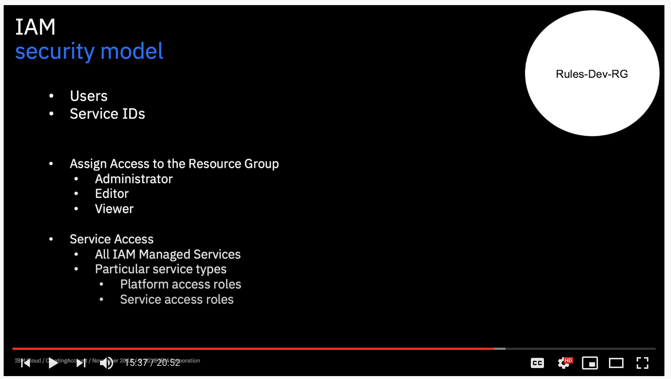
Section 1.9 – Identity and Access Management (IAM) - demo
https://www.youtube.com/watch?v=w2AyDVS2SSM

Slide 58
Notices and disclaimers
Copyright © 2020 by International Business Machines Corporation (IBM). No part of this document may be reproduced or transmitted in any form without written permission from IBM.
U.S. Government Users Restricted Rights — use, duplication or disclosure restricted by GSA ADP Schedule Contract with IBM.
Information in these presentations (including information relating to products that have not yet been announced by IBM) has been reviewed for accuracy as of the date of initial publication and could include unintentional technical or typographical errors. IBM shall have no responsibility to update this information. This document is distributed “as is” without any warranty, either express or implied. In no event shall IBM be liable for any damage arising from the use of this information, including but not limited to, loss of data, business interruption, loss of profit or loss of opportunity. IBM products and services are warranted according to the terms and conditions of the agreements under which they are provided.
IBM products are manufactured from new parts or new and used parts. In some cases, a product may not be new and may have been previously installed. Regardless, our warranty terms apply.”
Any statements regarding IBM's future direction, intent or product plans are subject to change or withdrawal without notice.
Performance data contained herein was generally obtained in a controlled, isolated environments. Customer examples are presented as illustrations of how those customers have used IBM products and the results they may have achieved. Actual performance, cost, savings or other results in other operating environments may vary.
References in this document to IBM products, programs, or services does not imply that IBM intends to make such products, programs or services available in all countries in which IBM operates or does business.
Workshops, sessions and associated materials may have been prepared by independent session speakers, and do not necessarily reflect the views of IBM. All materials and discussions are provided for informational purposes only, and are neither intended to, nor shall constitute legal or other guidance or advice to any individual participant or their specific situation.
It is the customer’s responsibility to insure its own compliance with legal requirements and to obtain advice of competent legal counsel as to the identification and interpretation of any relevant laws and regulatory requirements that may affect the customer’s business and any actions the customer may need to take to comply with such laws. IBM does not provide legal advice or represent or warrant that its services or products will ensure that the customer is in compliance with any law.

Slide 59
Notices and disclaimers continued
Information concerning non-IBM products was obtained from the suppliers of those products, their published announcements or other publicly available sources. IBM has not tested those products in connection with this publication and cannot confirm the accuracy of performance, compatibility or any other claims related to non-IBM products. Questions on the capabilities of non-IBM products should be addressed to the suppliers of those products. IBM does not warrant the quality of any third-party products, or the ability of any such third-party products to interoperate with IBM’s products. IBM expressly disclaims all warranties, expressed or implied, including but not limited to, the implied warranties of merchantability and fitness for a particular, purpose.
The provision of the information contained herein is not intended to, and does not, grant any right or license under any IBM patents, copyrights, trademarks or other intellectual property right.
IBM, the IBM logo, ibm.com, Aspera®, Bluemix, Blueworks Live, CICS, Clearcase, Cognos®, DOORS®, Emptoris®, Enterprise Document Management System™, FASP®, FileNet®, Global Business Services®, Global Technology Services®, IBM ExperienceOne™, IBM SmartCloud®, IBM Social Business®, Information on Demand, ILOG, Maximo®, MQIntegrator®, MQSeries®, Netcool®, OMEGAMON, OpenPower, PureAnalytics™, PureApplication®, pureCluster™, PureCoverage®, PureData®, PureExperience®, PureFlex®, pureQuery®, pureScale®, PureSystems®, QRadar®, Rational®, Rhapsody®, Smarter Commerce®, SoDA, SPSS, Sterling Commerce®, StoredIQ, Tealeaf®, Tivoli® Trusteer®, Unica®, urban{code}®, Watson, WebSphere®, Worklight®, X-Force® and System z® Z/OS, are trademarks of International Business Machines Corporation, registered in many jurisdictions worldwide. Other product and service names might be trademarks of IBM or other companies. A current list of IBM trademarks is available on the Web at "Copyright and trademark information" at: www.ibm.com/legal/copytrade.shtml.

